Slide 1
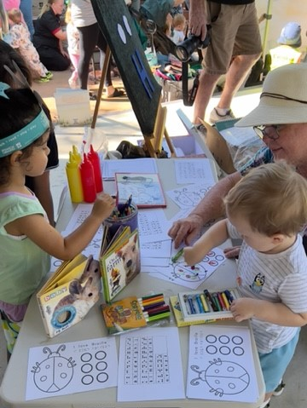
Braille Awareness Presentations
The Braille Awareness Presentations are designed to introduce students to tactile experiences and to enhance their knowledge and awareness of Braille as well as blindness and low vision.
Presentations run for about 45 mins and include elements of learning, storytelling and craft that are all focused on reading inclusion, equality and diversity.
Shows only $425 (inc GST)
(Up to 25 children)
BOOK NOW!!!
Phone: 07 3848 5257
Email: kkieu@qbwa.org.au
www.braillehouse.org.au

